Slide 1
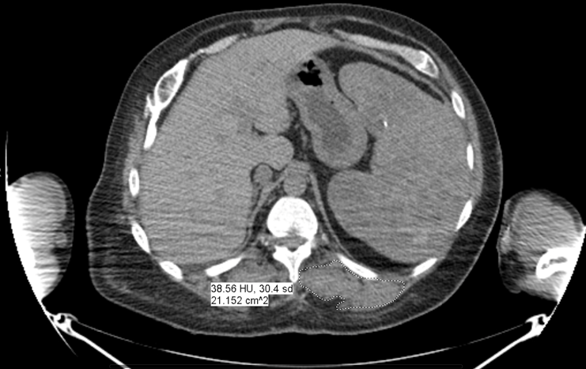
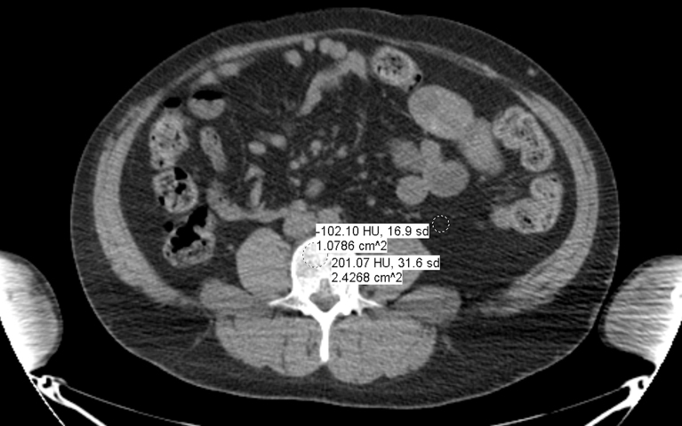
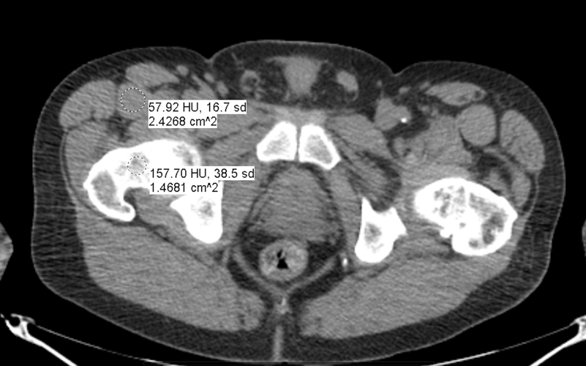
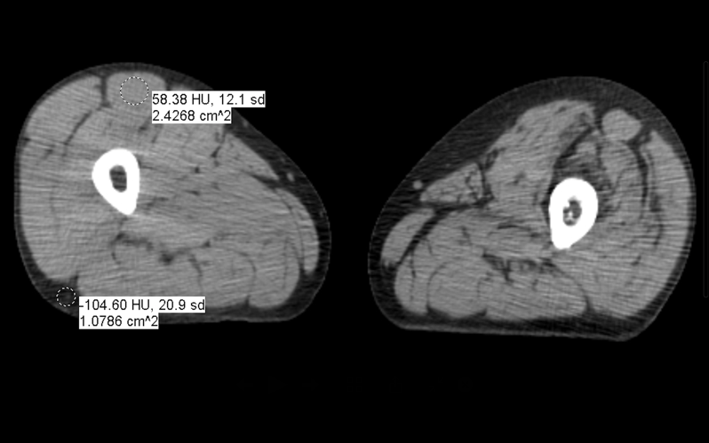
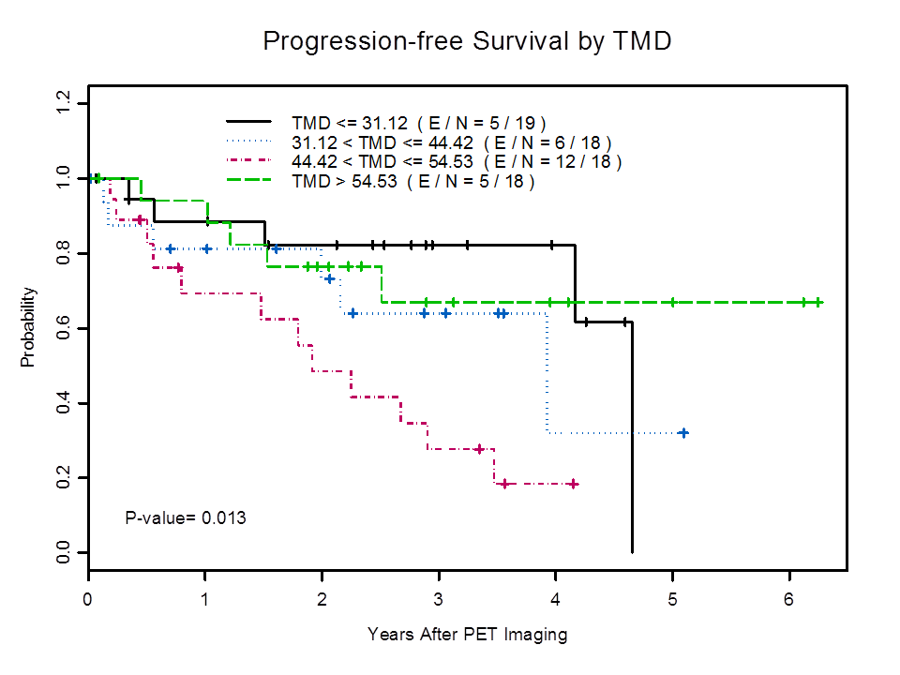
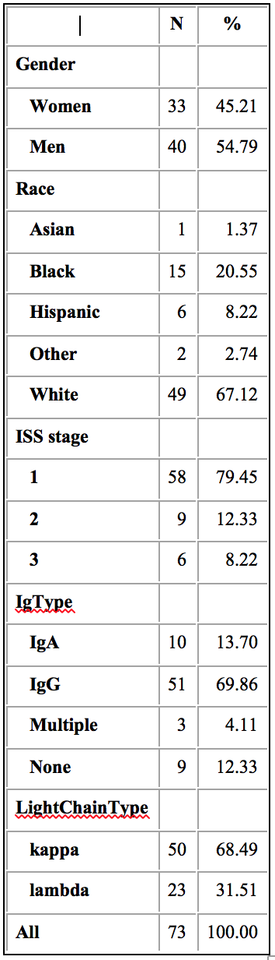
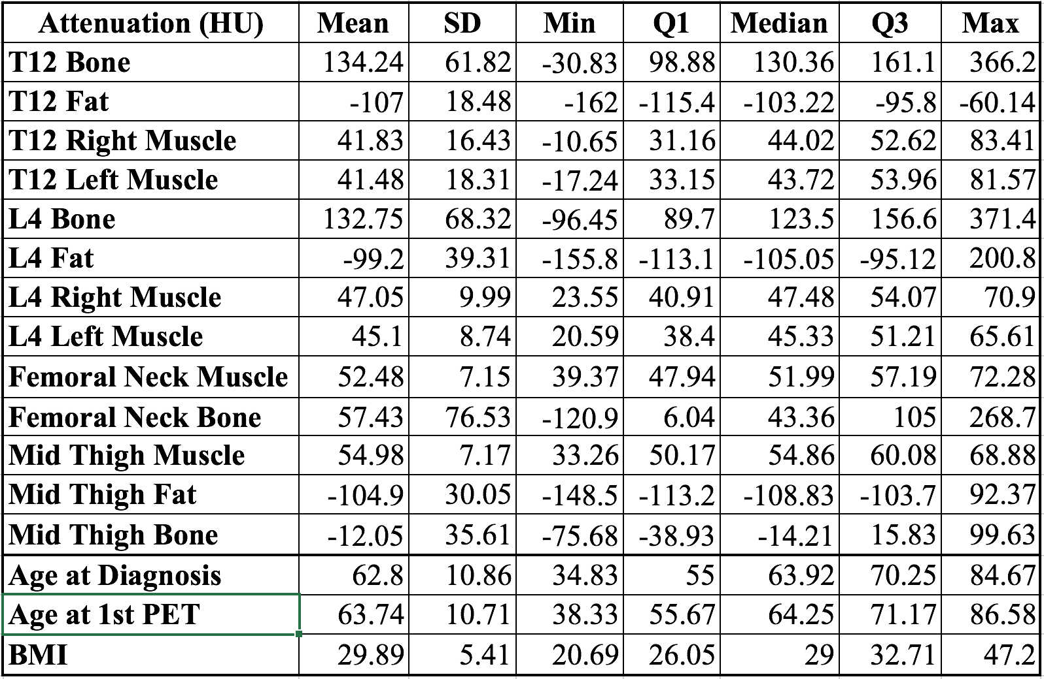

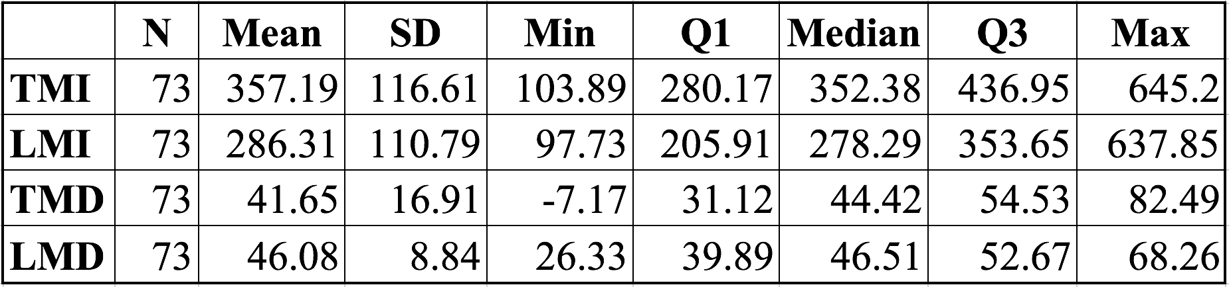
PET-CT Evaluation of Bone, Muscle, and Adipose Tissue:
Feasibility of Serendipitous Biomarkers for Patients with Smoldering Multiple Myeloma
Yves-Paul N. Nakache, MS¹, Behrang Amini, MD, PhD², Elisabet Manasanch, MD³, Wei Wei⁴, Leon Lenchik, MD⁵, Robert D. Boutin, MD¹.
¹University of California, Davis Medical Center; ²Department of Diagnostic Radiology, ³Department of Lymphoma/Myeloma, ⁴Department of Biostatistics at M.D. Anderson Cancer Center; ⁵Wake Forest Baptist Medical Center
INTRODUCTION
excluded from analysis if there was incomplete clinical data or diagnostically limited PET-CT scans. This yielded 73 patients for our evaluation.
Clinical data were collected, including: (1) demographics (i.e., age, sex, race, height, weight, body mass index (BMI)), (2) stage (International Staging System) and laboratory results (i.e., albumin, calcium, creatinine, light chains, M protein, Bence Jones protein), and (3) patient outcome after 1 year (i.e., SMM, MM, death).
CT Measurements
Measurements were made by a medical student after a training phase and then with subsequent quality assurance and agreement by consensus provided by a board-certified radiologist with 20 years of subspecialty experience in musculoskeletal imaging. Measurements were blinded to all clinical data and were carried out with clinical PACS software (iSite v3.6, Philips Healthcare) that is used routinely by healthcare providers in the UC Davis Health enterprise.
Using non-contrast axial CT images, a total of 13 regions of interest to assess bone, muscle, and adipose tissue were outlined for each patient at 4 anatomic levels (Figure 1):
T12 level: Vertebral body (cancellous bone) & visceral fat
Right and left paraspinal muscles
L4 level: Vertebral body (cancellous bone) & visceral fat
Right and left psoas muscle
Femoral neck: Rectus femoris muscle & cancellous bone
Mid thigh: Rectus femoris muscle & fat
Cancellous bone
Cross-sectional areas (CSA) in cm² were normalized for patient height (PH) in m². The average attenuations (AA) or “densities” of tissues also were recorded:
Thoracic muscle index (TMI): paravertebral muscle CSA/PH²
Lumbar muscle index (LMI): psoas muscle CSA/PH²
Thoracic muscle density (TMD): paravertebral muscle AA
Lumbar muscle density (LMD): psoas muscle AA
Statistical Analysis
Baseline demographic and clinical characteristics were summarized using descriptive measures. The association of patient mortality versus baseline CT metrics versus SMM progression and overall survival was performed using logistic regression and Cox proportio-nal hazards models. Primary outcomes include: Progression from SMM to MM and overall survival
Curves for survival and progression of disease for the quartiles of derived indices (TMI, LMI, TMD, LMD) were generated (Tab. 2). Kaplan-Meier survival analysis for TMD is shown in Fig. 2. Additional curves are currently being plotted to evaluate other different measures (CSA and AA of osseous, muscle and adipose tissues at femoral neck & mid thigh levels) in Tab. 3.
Multiple myeloma (MM) is the most common primary malignancy in bone and is expected to increase in prevalence as our population ages [1]. Smoldering Multiple Myeloma (SMM), also called asymptomatic multiple myeloma, is the intermediate stage between Monoclonal Gammopathy of Undetermined Significance (MGUS) and symptomatic MM [2]. 65% of patients with SMM progress to MM within 10 years [2].
Positron Emission Tomography-Computed Tomography (PET-CT) exams are performed almost 2 million times each year in the USA [3]. Patients with SMM commonly undergo PET-CT to assess the metabolic and anatomic extent of osseous disease [2, 4]. PET enables assessment of tissue metabolism by using FDG, an analog of glucose, which is quantitated as a standardized uptake value (SUV). CT allows for assessment of anatomic features, including cross-sectional area (measured in cm²) and tissue attenuation (measured in Hounsfield units (HU)).
Although SMM patients commonly undergo PET-CT in order to assess the extent of osseous disease [2], muscle and adipose tissue are not routinely evaluated. Given that muscle and adipose tissue are now regarded as endocrine-like organs with systemic influences (e.g., via proinflammatory cytokines) [5, 6], these tissues are hypothesized to influence transduction pathways associated with plasma cell proliferation in bone marrow. Although diet-induced obesity has been shown to promote a myeloma-like condition in mice, little is known about the relationship of imaging biomarkers and myelomagenesis in humans.
DISCUSSION
Bone, muscle, and fat are now regarded as having endocrine-like influences that could have important systemic effects. For example, with muscle, depletion measured on CT is an important predictor of excess mortality in patients with advanced forms of cancer [7], but this technique has not been used to assess patients with SMM. Similarly, although Visceral Adipose Tissue (VAT) is associated with pro-inflammatory states and the development of certain cancers [8, 9], CT-measured VAT had not been used as a method to predict the progression of SMM to MM. In this study, we demonstrated the feasibility of opportunistically obtaining measures of bone, muscle, and fat from routine PET-CT scans.
In our pilot analysis of CT muscle metrics, we did not find a statistically significant association with SMM progression to MM or with mortality rate. The absence of statistical significance may indicate that these metrics are not predictive of adverse outcome or may be due to a small cohort size of 73 patients and only 4 deaths. The cohort size was a primary limitation of this study. Additional patients with a spectrum of myelomatous diseases could be added in subsequent work to further power this line of investigation to identify clinical relevant radiomic features.
Ongoing work in our cohort includes further biostatistical analysis to assess associations between patient outcomes and CT measurements of bone, muscle, and fat obtained in the chest, abdomen, hip, and thigh regions. In addition, future work will opportunistically evaluate PET SUV measurements of metabolic activity in bone, muscle, and fat tissues.
A B
C D
RESULTS
Patient Characteristics & Outcomes
Demographic and clinical characteristics are detailed in Table 1. Of 73 patients with SMM, 24 (32.9%) progressed to MM and 4 (5.5%) died. Clinical follow-up duration averaged 3.02 years (range, 0 -11.65 years).
Fig.1: Axial non-contrast CT scan showing representative measurements: [A] at T12, left paraspinal muscle attenuation and cross-sectional area, [B] at L4, visceral fat and bone attenuations, [C] at the femoral neck, bone and rectus femoris attenuations, and [D] at the mid thigh, rectus femoris muscle and fat attenuations.
OBJECTIVES
Although biomarkers of body composition are not evaluated currently on PET-CT, we hypothesize that the quantity and quality of bone, muscle, and adipose tissue can be measured serendipitously on routine PET-CT exams. Specifically, our aim is to opportunistically evaluate adverse metabolic and morphologic features of bone, muscle, and adipose tissue using PET-CT scans that are already obtained in patients with SMM to assess for conversion to MM. Our objective is to assess the feasibility of analyzing quantitative CT biomarkers of body composition – bone, muscle, and fat – that may be associated with progression of SMM to MM, and from MM to death.
Fig.2: Progression-free survival for patients stratified by TMD. The 3rd quartile was associated with worse survival.
CONCLUSION
This study demonstrates the feasibility of the serendipitous analysis of body composition -- bone, muscle, and fat -- on routine PET-CT exams in order to assess body composition.
Tab.1: Patients Characteristics
REFERENCES
METHODS
To access the references, please use the barcode reader application of your cellphone.
After institutional review board approval and approval of a material transfer agreement, we performed a retrospective study by searching a prospectively maintained database from 01/01/2005 to 07/01/2015 at a large academic medical center (MD Anderson Cancer Center, Houston, TX) for patients who met the following three inclusion criteria: (a) adults with the diagnosis of SMM, (b) contemporaneous PET-CT scan, and (c) clinical and laboratory follow-up of > 1 year. Patients were
Tab.3:
Summary of individual measurements
Tab.2: Summary of indices
ACKNOWLEDGEMENTS
The authors would like to express their sincere appreciation to J. Anthony Seibert, Ph.D., Assistant Vice-Chair of Radiology Informatics for his invaluable help with the research PACS. We also express our gratitude for the UC Davis School of Medicine which made this research project possible and provided material support and outstanding mentorship.

